Slide 1
Nordic prescription registers Norway
Kari Furu
Dept of Pharmacoepidemiology
Norwegian Institute of Public Health
NorPEN meeting in Odense 13th October 2011

Slide 2
Essential demographics Norway
Size of population: 4 953 000 ( 1 July 2011)
Detailed public statistics available at http://www.ssb.no/english/

Slide 3
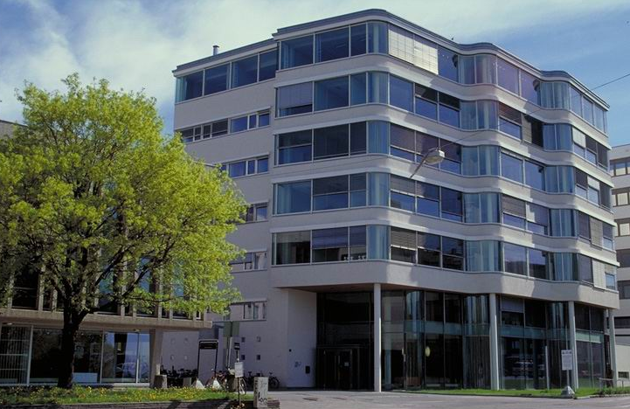
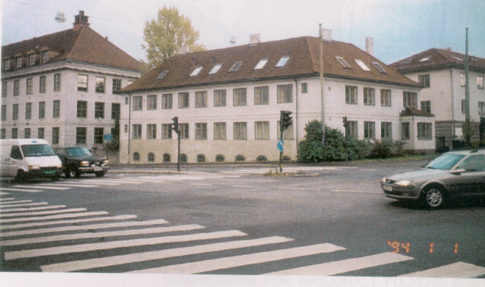
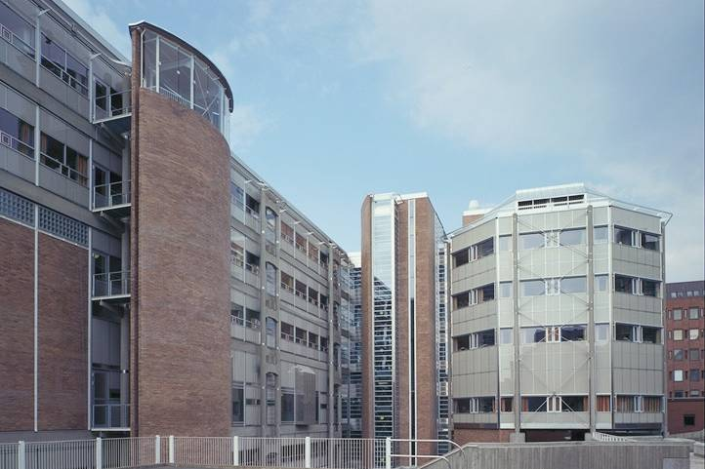
Relevant host institutions
The Norwegian Institute of Public Health (NIPH)
Division of Epidemiology
Health registers
Health surveys
Norwegian Prescription Database (NorPD)
~ 1200 employees
Host for 7 nationwide health registers +
Mother & Child cohort,
Populationbased health surveys
Division of
Environmental Medicine
Mental Health
Division of
Forensic Medicine and Drug Abuse Research
Infectious Disease Control
Notes:
Grunnlagt i 1929 for å bekjempe epidemier og infeksjonssykdommer
På 1920-tallet var Norge et av Europas aller fattigste land. Det var derfor økonomisk sett umulig for staten å etablere et eget folkehelseinstitutt. Takket være en betydelig donasjon fra Rockefeller Foundation ble det i 1929 likevel mulig å etablere et folkehelseinstitutt i Geitmyrsveien 75, Lindern, Oslo.
Dette ble starten på en lang og fremgangsrik historie for det norske folkehelseinstituttet. Det mikrobiologiske miljøet ved instituttet har hatt en enorm betydning for utviklingen av mikrobiologi i Norge. Til å begynne med var smittevern og infeksjonssykdommer de største utfordringene. Etter hvert har instituttet tatt opp i seg en rekke andre områder som miljømedisin, samfunnsmedisin, og etter hvert psykisk helse, sosiale miljøfaktorer og rusmiddelforskning og rettstoksikologi. Nasjonalt folkehelseinstitutt, slik vi kjenner det i dag, ble til som et ledd i fornyelsen av den sentrale sosial- og helseforvaltningen i 2002. Det nye instituttet ble satt sammen av store deler av Statens institutt for folkehelse og Statens helseundersøkelser, Medisinsk fødselsregister og Enhet for legemiddelstatistikk- og metodologi fra Norsk medisinaldepot. Fra 2003 er tidligere Statens rettstoksikologiske institutt (SRI) blitt den nye Divisjon for rettstoksikologi og rusmiddelforskning i instituttet. Store deler av instituttet er fortsatt lokalisert på Lindern i Oslo, og det opprinnelige instituttets historiske bygninger er fortsatt delvis i bruk. I løpet av noen få år vil alle instituttets arbeidsplasser i Oslo nok en gang være samlet på Lindern i nye lokaler slik det opprinnelig var i 1929.

Slide 4
The Department of Pharmacoepidemiology Main tasks/responsibilities
The Norwegian Prescription Database (NorPD)
committee which considers all applications for data from NorPD
The Norwegian Drug Wholesales Statistics
Pharmacoepidemiologic Research Unit
The WHO Collaborating Centre for Drug Statistics Methodology
Staff August 2011: 20 (Researchers, Senior Advisors, PhD students, administrative staff)

Slide 5
Prescription variables, what is covered?
Patient
Person-identifier, month/year of birth & death, gender, place of residence
Prescriber
Person-identifier, age, gender, profession, speciality
Drug
Nordic Article Number (brand name, strength, package size)
ATC code, Defined Daily Doses (DDD), Number of packages
Date of dispensing, Price
Code of reimbursement (from March 2008: ICD10 or ICPC)
Pharmacy
Licence number, name, location area (municipality, county)
List of variables available at: http://www.fhi.no/dokumenter/a613d90f37.xls
Notes:
Based on information on the prescriptions + information from administrative registers

Slide 6
Prescription variables, what is not covered?
Prescription date
Prescribed dose (free text only)
Individual drug use given to individuals in hospitals and nursing homes
ongoing project to include individual drug use data from hospitals in NorPD
Indication on nonreimbursed drugs
But on reimbursed drugs there are reimbursement codes
2004-2008 ”rough” codes
2009→ICD-10 or ICPC-2 codes
Karlstad Ø, Tverdal A, Skurtveit S, Nafstad P, Furu K. Comorbidities in an asthma population 8-29 years old - a study from the NorPD. Pharmacoepidemiol Drug Saf. 2011. Epub 2011 Sep 23

Slide 7
Coverage of prescription database
Nationwide prescription database
All residents, independent of income
All drugs dispensed from all pharmacies in Norway
Reimbursed (all kind of reimbursement types) and nonreimbursed drugs
Licensed and nonlicensed drugs (compassionate use/on a named patient basis)
NIPH have a complete database of the NorPD since January 2004

Slide 8
Available data in Norway on hospitalisations and examples of other variables
Norwegian Patient Register (NPR) from 2007, owned by the Norwegian Directorate of Health (Helsedirektoratet)
http://www.helsedirektoratet.no/norsk_pasientregister/
Information from hospitals, specialist care, adult & children/youth psychiathry
Cancer Registry of Norway from 1952 owned by South-Eastern Norway Regional Health Authority (Helse SørØst)
http://www.kreftregisteret.no/en/
Main health registers inhouse at NIPH (www.fhi.no):
Medical Birth Registry of Norway (MBRN) from 1967
Cause of Death from 1925/1951
Vaccinations (SYSVAK) from 1998
Population health surveys
Statistics Norway: education, marital status, income, emigration
http://www.ssb.no/english/

Slide 9
How to apply for data from Norwegian Institute of Public Health?
NIPH hosts NorPD and 7 other nationwide health registers, but for the Cancer registry and the Patient registry you have to apply for data from their hosts
All data with personal identity number (PIN) have to be prepared with a special software delivered by NIPH to prepare the data for encrypting to achieve the same code as in NorPD. Files with the same project specific numbers are delivered from NIPH, dept of Pharmacoepidemiology. Linkage enabled by this mutual encrypted PIN
Individual-level data with project specific numbers are delivered as separate files from NIPH to researchers
A team of 6 people (jurist, researchers, adm staff) consider all applications
All questions and applications should be sent to datatilgang@fhi.no
Contact persons: elisabeth.eriksen@fhi.no or milada.mahic@fhi.no

Slide 10
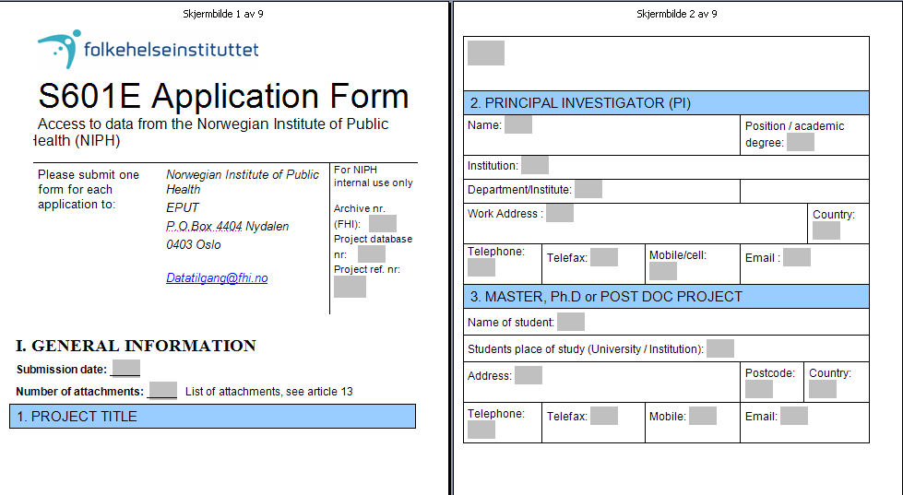
Access to data from NorPD All applications should be sent to datatilgang@fhi.no
Licence from the the Norwegian Data Protection Agency is needed when data from the NorPD is linked to other data sources (e.g. sociodemographic data from SSB), but a notification to the Chief Privacy Officer is sufficient when linked to other nationwide health registers

Slide 11
Practicalities
Whom to approach
www.fhi.no & datatilgang@fhi.no for the NorPD + 7 health registers
http://www.ssb.no/english/ for sociodemographic variables
http://www.helsedirektoratet.no/norsk_pasientregister/ for Norwegian Patient Register
http://www.kreftregisteret.no/en/ for the Norwegian Cancer Registry
Approvals
Ethics approval not (usually) required for register studies
Licence from the Norwegian Data Protection Agency is needed when data from NorPD is linked to other data sources (e.g. sociodemographic data from SSB), but a notification to the Chief Privacy Officer (Personvernombud(PVO) is sufficient when only linked to other nationwide health registers, http://www.datatilsynet.no/
Costs
For data from health registers at NIPH there is an hourly rate of 875/1100 Norwegian kroner (NOK) for preparation and dispatch, minimum NOK 1750 + VAT for tables, 15000/25000/50 000 NOK for data files depending on complexity of the datasets
Time:
30/60 working days from complete application is received by NIPH

Slide 12
A few examples of papers
Skurtveit S, Furu K, Handal M, Borchgrevink P, Fredheim O. To what extent does a cohort of new users of weak opioids develop persistent or probable problematic opioid use? Pain 2011;152:1555-61
Furu K, Karlstad Ø, Skurtveit S, Håberg SE, Nafstad P,London SJ, Nystad W: High validity of mother-reported use of antiasthmatics among children: a comparison with a population-based prescription database. J Clin Epidemiol 2011;64:878-84.
Kjosavik SR, Ruths S, Hunskaar S. Use of addictive anxiolytics and hypnotics in a national cohort of incident users in Norway. Eur J Clin Pharmacol 2011 Sep 18. [Epub ahead of print]
Engeland A, Bjørge T, Daltveit AK, Skurtveit S, Vangen S, Vollset SE, Furu K: Risk of diabetes after gestational diabetes and preeclampsia. A registry-based study of 470,000 women in Norway during 1988-2009. Eur J Epidemiology 2011;26:157-63.
Hjellvik V, Tverdal A, Furu K: Body mass index as predictor for asthma: a cohort study of 118 723 males and females. Eur Resp Journal 2010;35:1235-42.
Furu K, Wettermark B, Andersen M, Martikainen JE, Almarsdottir AB, Sørensen HT. The Nordic Countries as a cohort for pharmacoepidemiological research. Basic & Clinical Pharmacology & Toxicology 2010;106:86-94
Fredheim OM, Skurtveit S, Breivik H, Borchgrevink P. Increasing use of opoids from 2004 to 2007 – Pharmacoepidemiological data from a complete national prescription database in Norway. European Journal of Pain 2010;14:289-294
Hartz I, Tverdal A, Skille E, Skurtveit S. Disability pension as a predictor of later use of benzodiazepines among benzodiazepines users. Soc Sci & Med 2010;70:921-5

